Slide 1
Advancing Indigenous Land Rights and Conservation Through New Markets and Partnerships
Marc Baker Edward Loure
Carbon Tanzania Ujamaa Community Resource Team
&

Slide 2
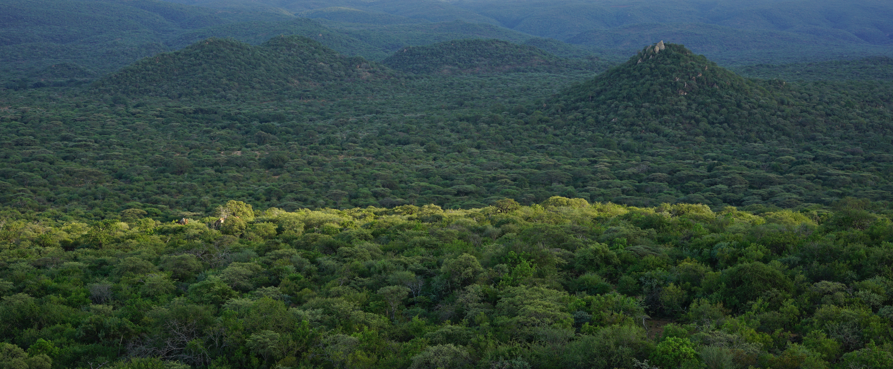
Notes:
Hadza CCRO in Yaeda

Slide 3
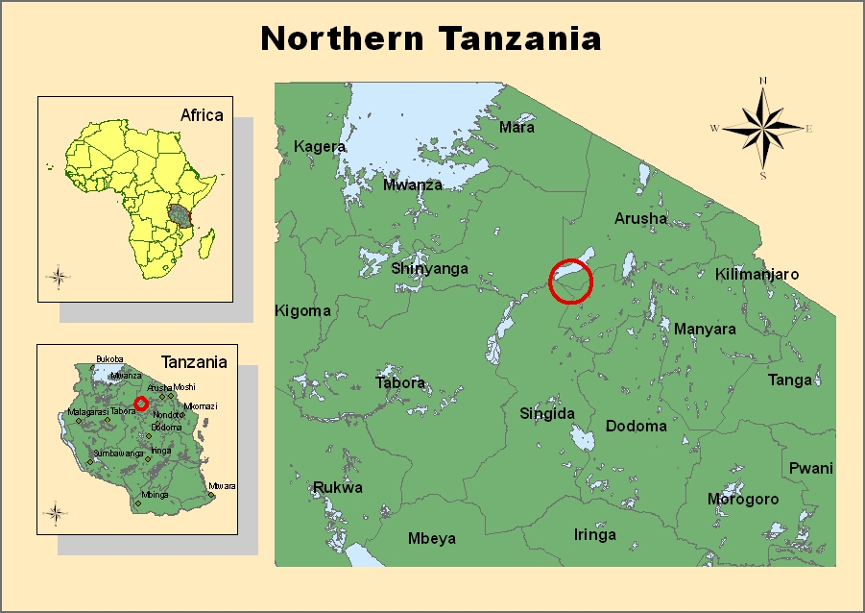
Notes:
Location of Yaeda

Slide 4
Northern Tanzania Rangelands Initiative focal area
1 million acres (400,000 km2)
Five National Parks
2 UNESCO sites
15 Forest Reserves
Ngorongoro Conservation Area
Makame WMA, the largest community conservation area in Tanzania
Notes:
Location of Yaeda and Makame in relation to Northern Tanzania Rangelands
Putting us on the map
Defining diversity – human (3 distinct linguistic groups). Wildlife – coexistence
Centre photographic tourism generating contributing 4.1Bn USD, 5% GDP

Slide 5
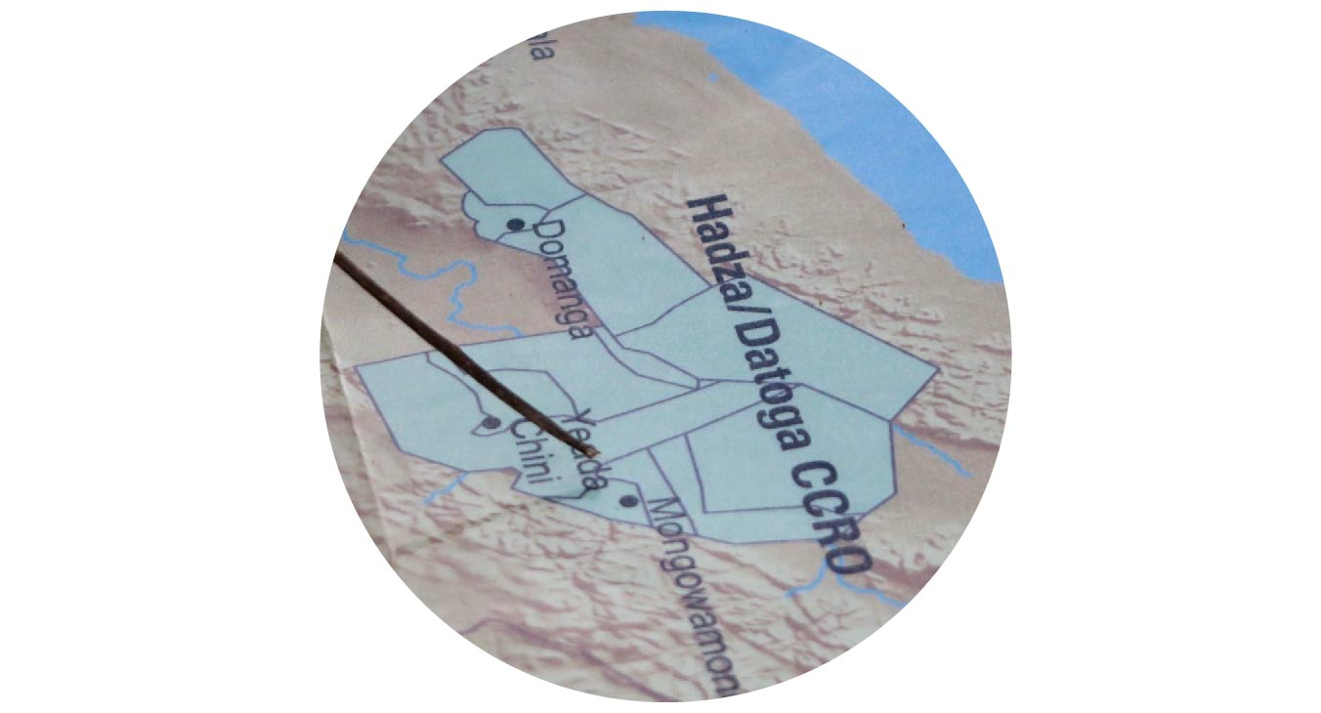
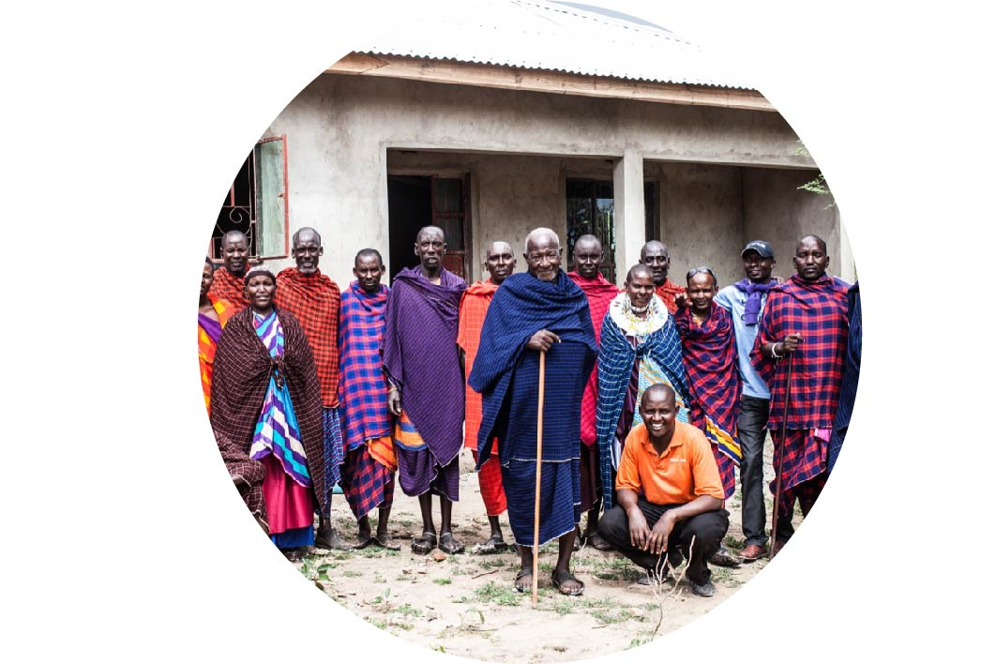
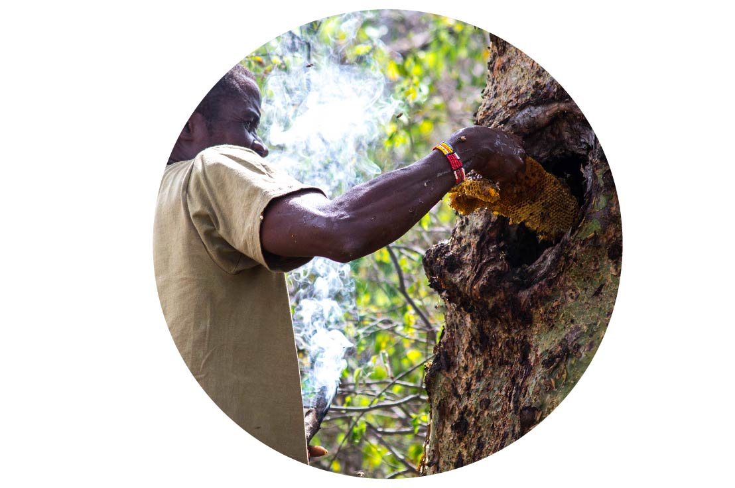
Our Approach
Secure communal rights
Strengthen governance
Increase community benefits

Slide 6
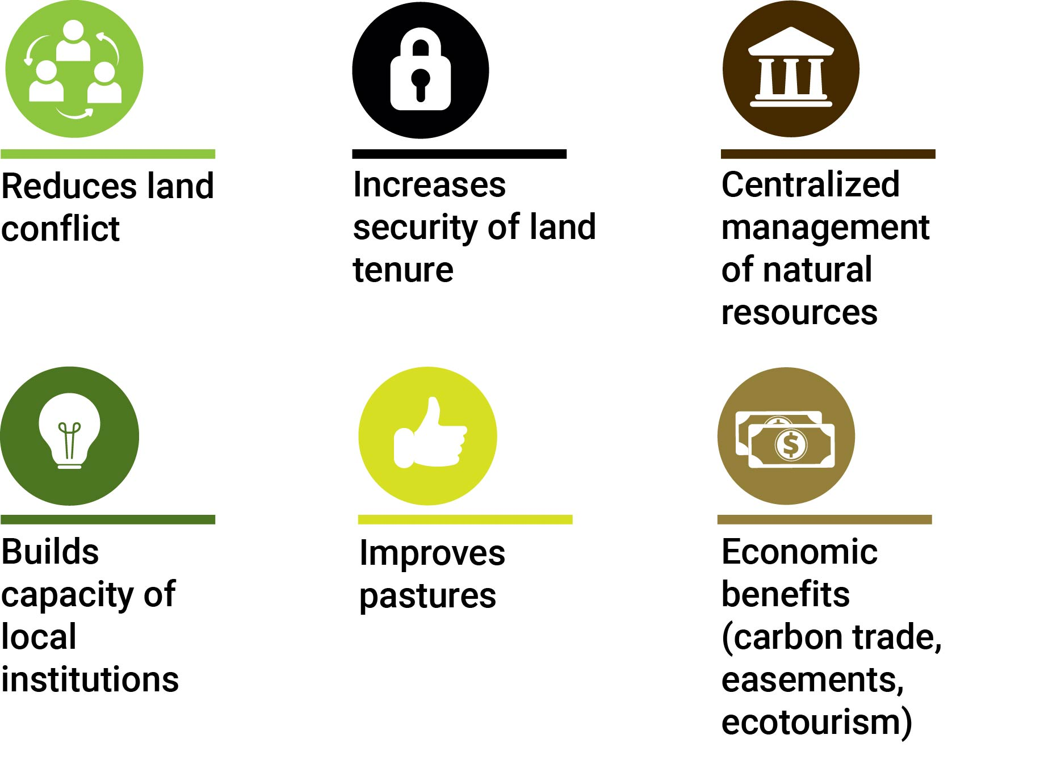
Benefits of Land Use Plans

Slide 7
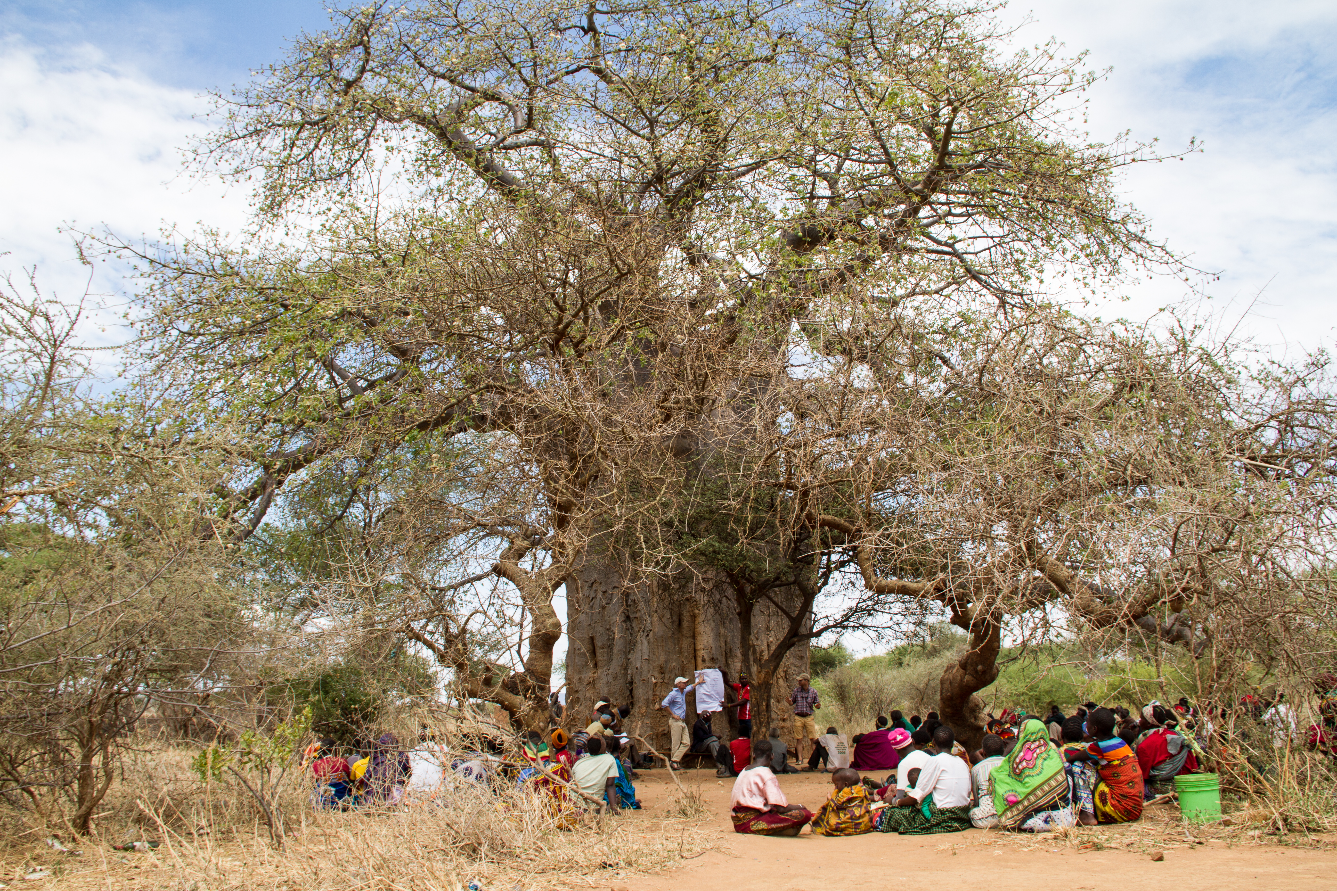

Slide 8
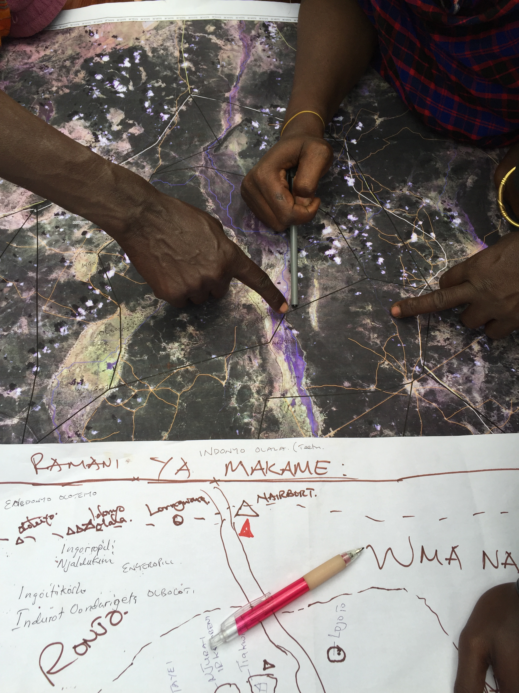

Slide 9
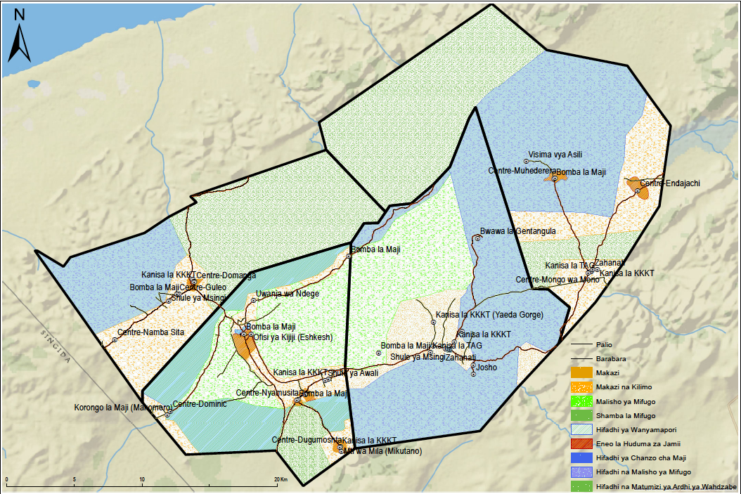
Combined Village Land Use Plans in the Yaeda Valley
Notes:
Emphasize continuity between plans

Slide 10
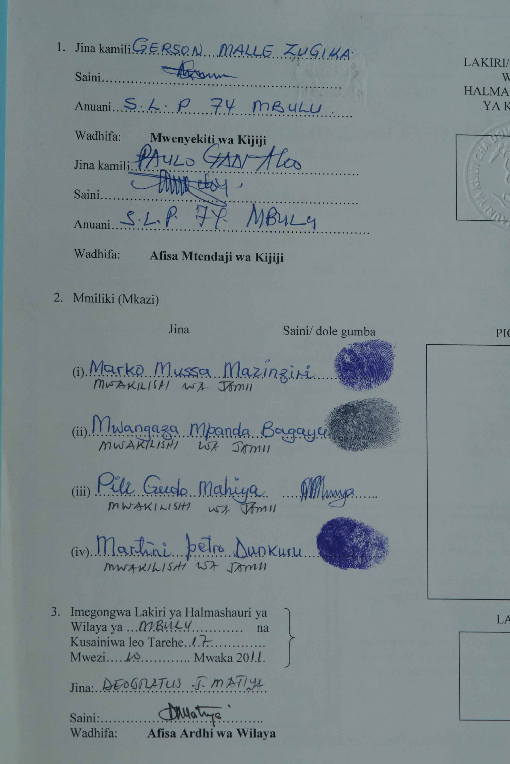
Certificate of Customary Right of Occupancy (CCRO)
“Communal lands are central to the livelihoods of many Tanzanians, particularly to pastoralists and hunter-gatherer groups.”
A Certificate of Customary Right of Occupancy (CCRO) is an effective tool for strengthening community land rights and securing communal lands provided for under the Village Land Act.
Notes:
CCRO committee;
Composition 2 representative from each sub village.(range btn 10-12 members) include traditional.
Appointed by village council and approved by village general Assembly.
Village general assembly approve the three trustees to sign Communal CCRO on behave of the community.
This is signed by the District Land Officer, note that three people couldn’t read and write to they finger printed

Slide 12
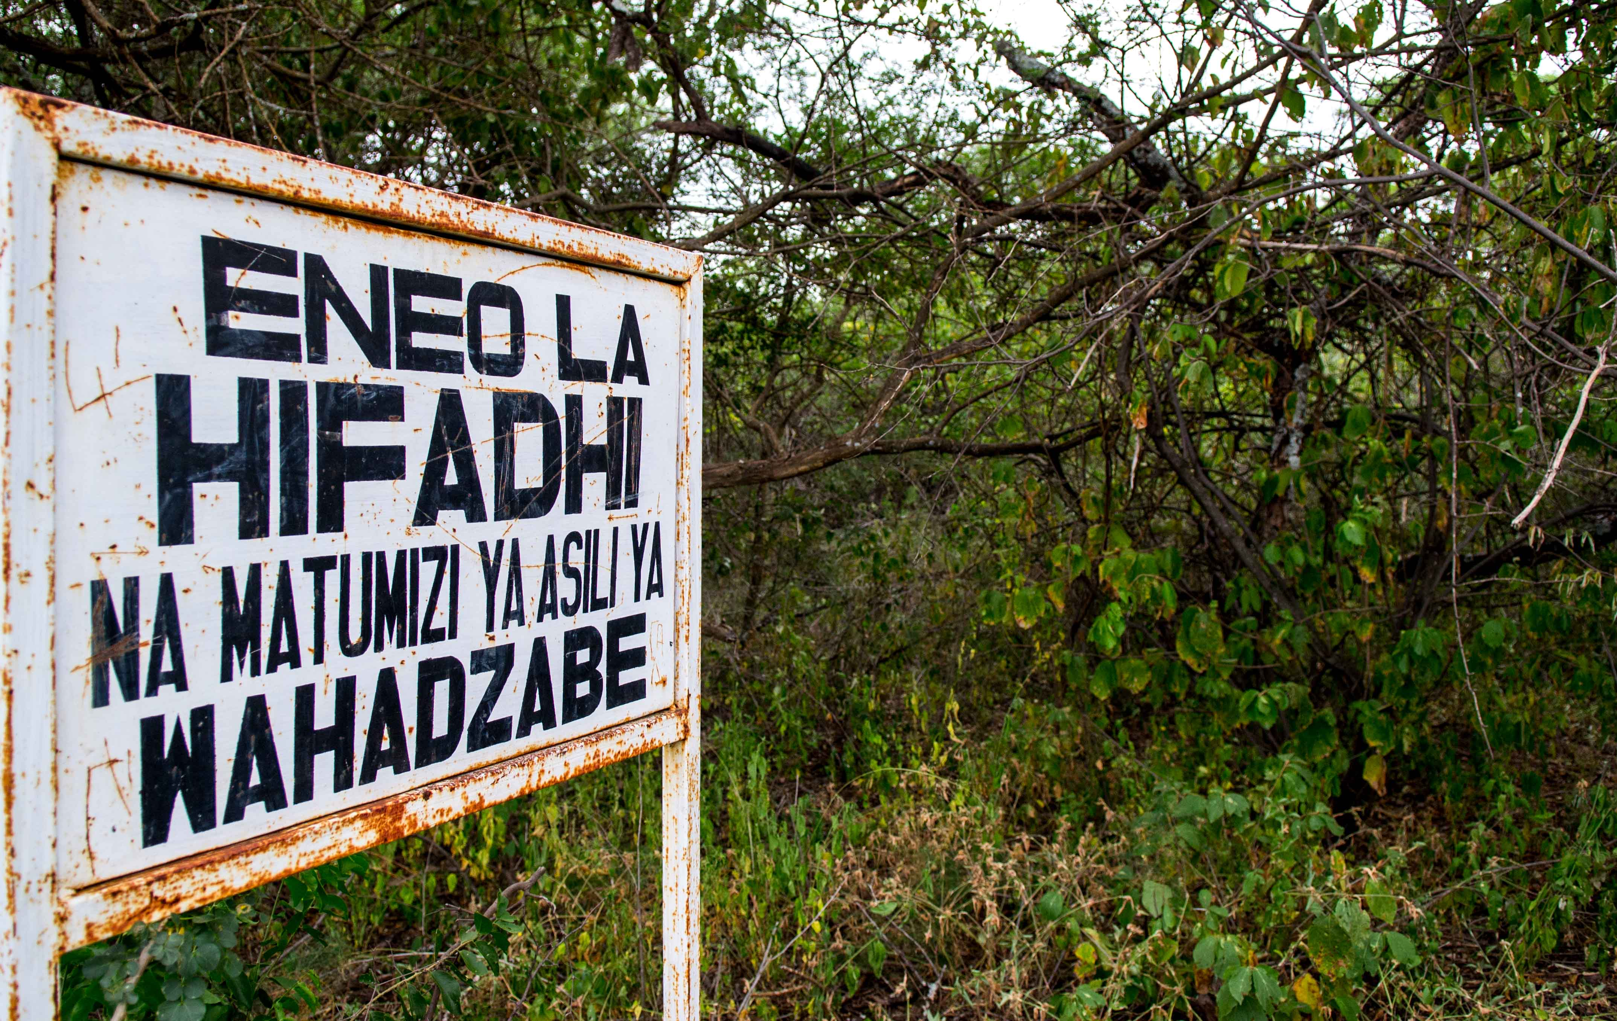

Slide 13
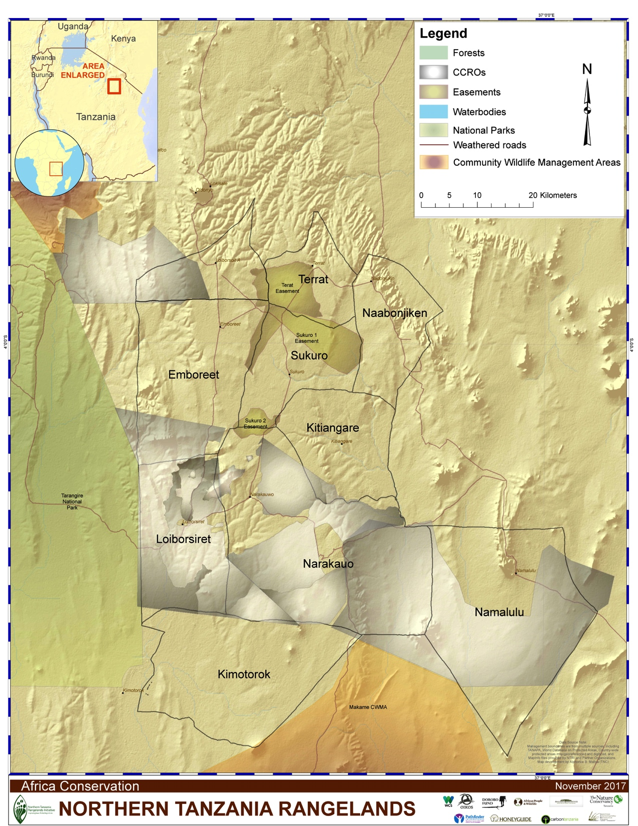
Tarangire National Park

Slide 14
Challenges
Politics
Cost
Bureaucracy

Slide 15
Recommendations
Notes:
Before division of villages let the responsible authority seek pre consent of local communities and stake holders.
The responsible district councils should allocate budget or contribution for LUP process.
Women and youth participation in LUP for future sustainability.
PLUM follow up on the progress of LUP after phase out of the program.

Slide 16
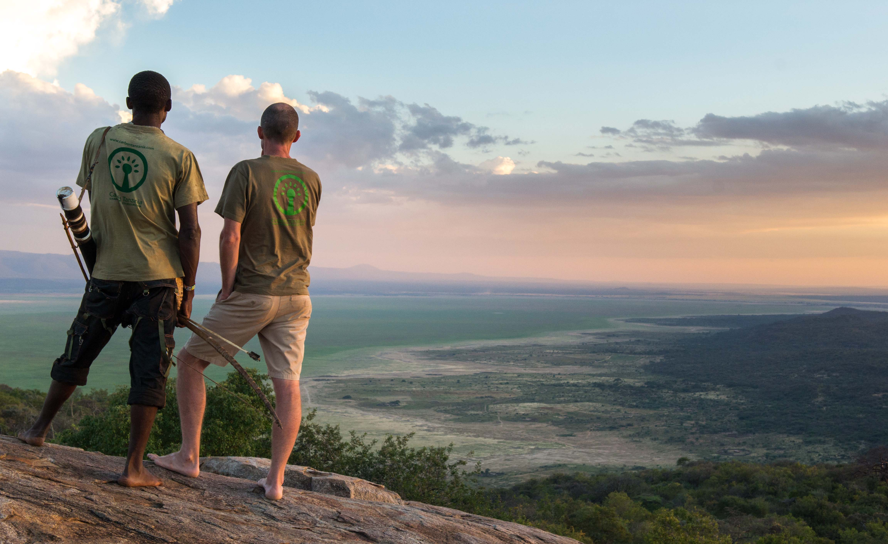
Notes:
Yaeda Valley – wrap up UCRT and introduce the next section.

Slide 17
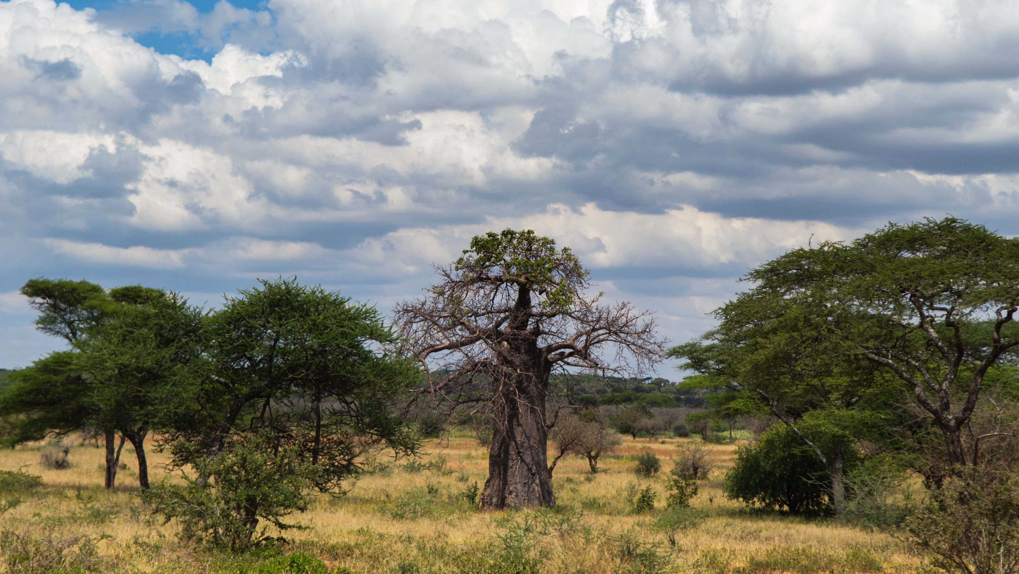
Valuing Landscapes Through Ecosystem Services
REDD as a mechanism to reduce land use change
Marc Baker
Carbon Tanzania

Slide 18
Notes:
Take a moment to understand the Hadza – ‘when they walk through the forest it is like you in a supermarket…’
Who are the Hadza and why is land so critical to them – land is life
Legalise resource ownership, land ownership
Mapping of microbiome – their diversity is a reflection of their ecosystem

Slide 19
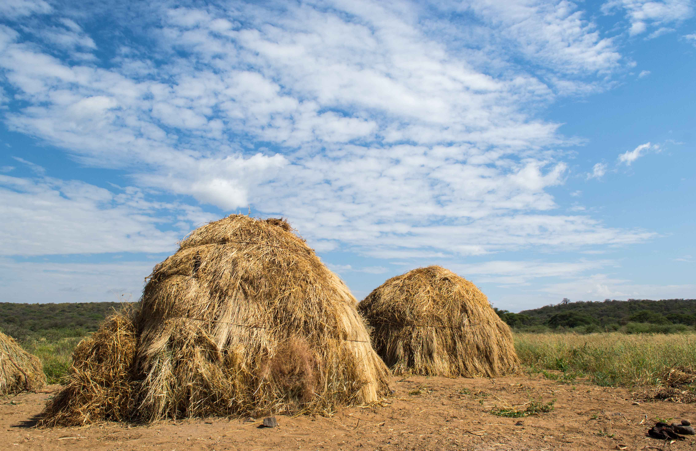
Notes:
Mobility – responding to a changing environment – itinerant behavior responding to a changing environment
Homo sapien ‘canary in a coal mine’

Slide 20
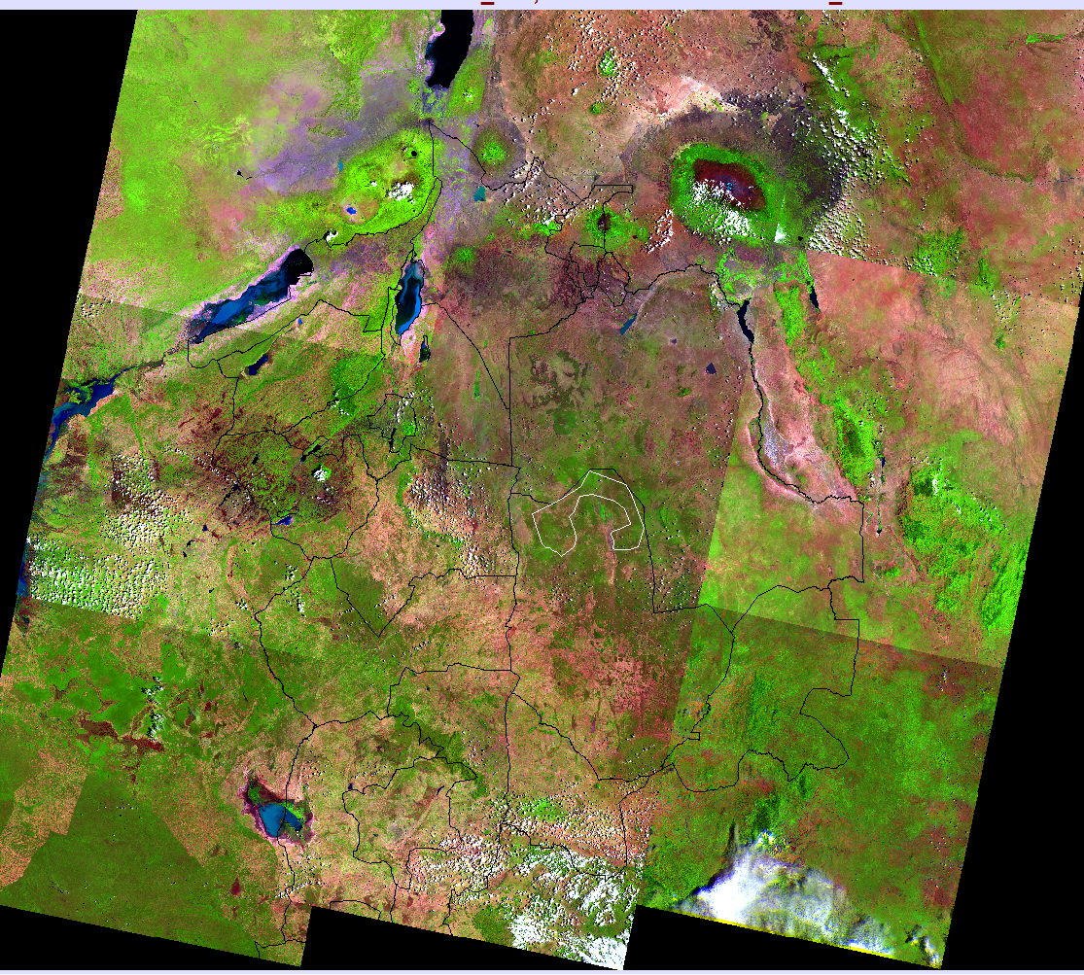
Our area of interest – Northern Tanzania
11 Landsat scenes covering an area of 380,000 km2 or 900,000acres
Serengeti NP
Kilimanjaro
Yaeda
Tarangire NP
Reference region for understanding landscape level land use change over 15 years is shown in red
Usambara Mts
Makame
WMA
Muhesi GR
Dodoma
Notes:
11 LandSat scenes – each 184 x 184 km – 380,000km2
Red area ‘reference region’
Diverse habitats – montane forest, somali-masai biome – acacia woodland
100 years ago dominated by pastoralists

Slide 21
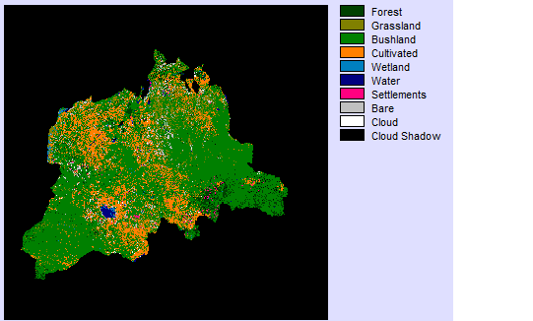
2005
Yaeda Valley
Makame WMA
Notes:
Cultivation in orange

Slide 22
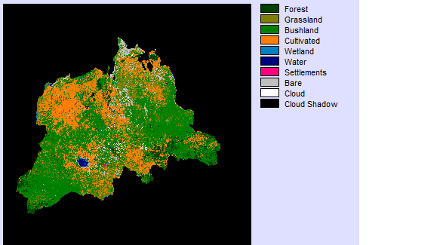
2010
Yaeda Valley
Makame WMA

Slide 23
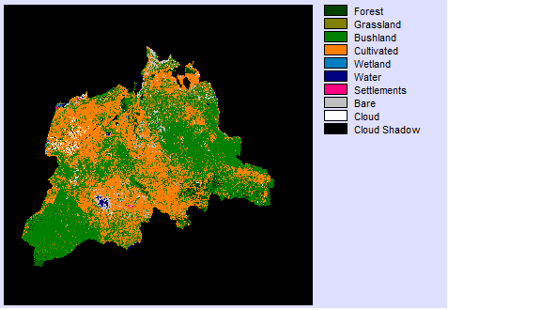
2015
Yaeda Valley
Makame WMA
The rate of change is 181,035ha of woodland and forest lost per year, or ~9% per annum

Slide 24
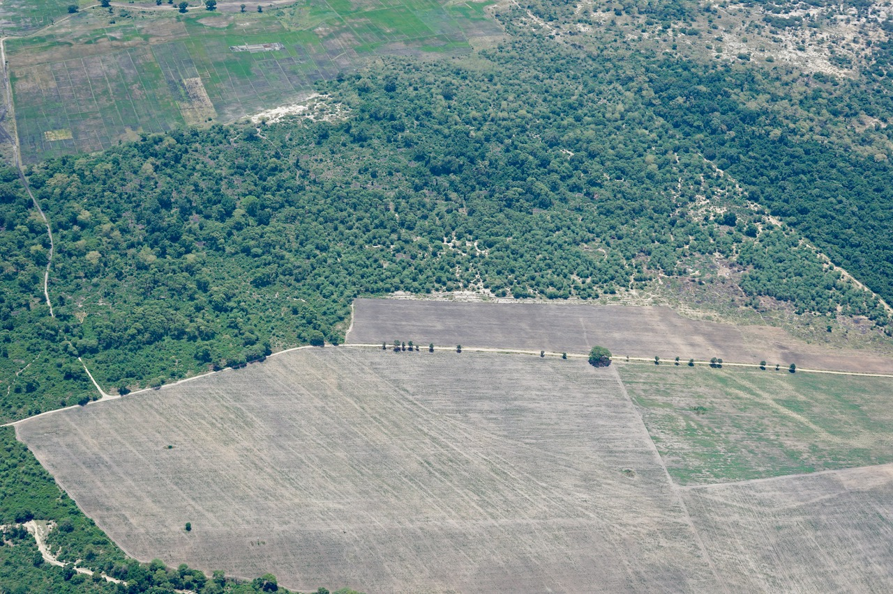

Slide 25
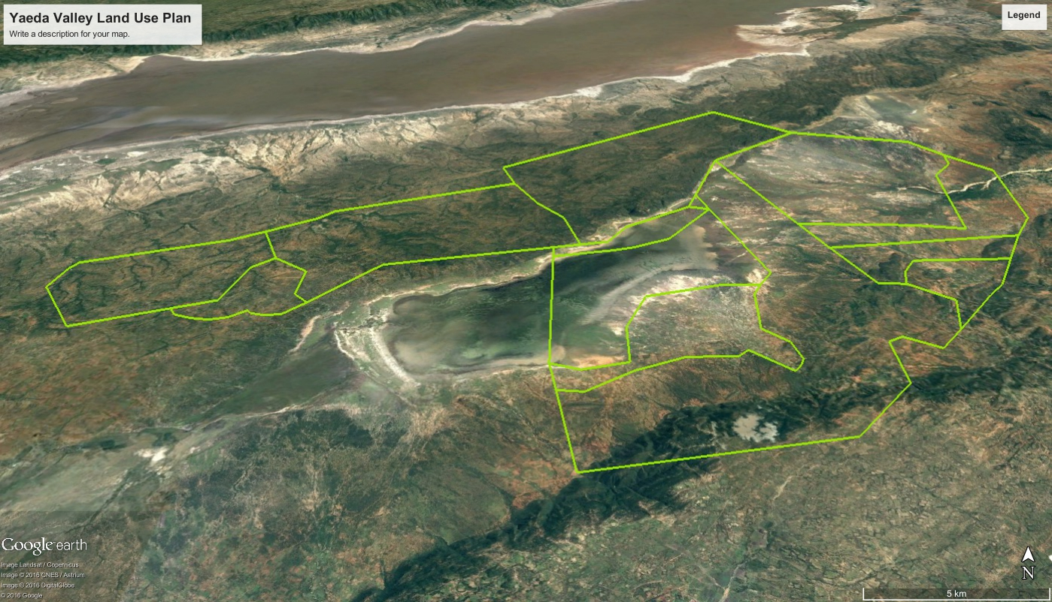
Ngorongoro Conservation Area
Lake Eyasi
CCRO - Grazing
CCRO - Protected for Hadza lifestyle
CCRO - Grazing
Agricultural
Agricultural
Agricultural
CCRO - Grazing
Land use plan – resource use
Notes:
What does it look like in reality
Landsat map of the Yaeda Valley, Northern Tanzania
Zones of use designed by communities
Where carbon Tanzania can overlay its protective boundary and account for the carbon

Slide 26
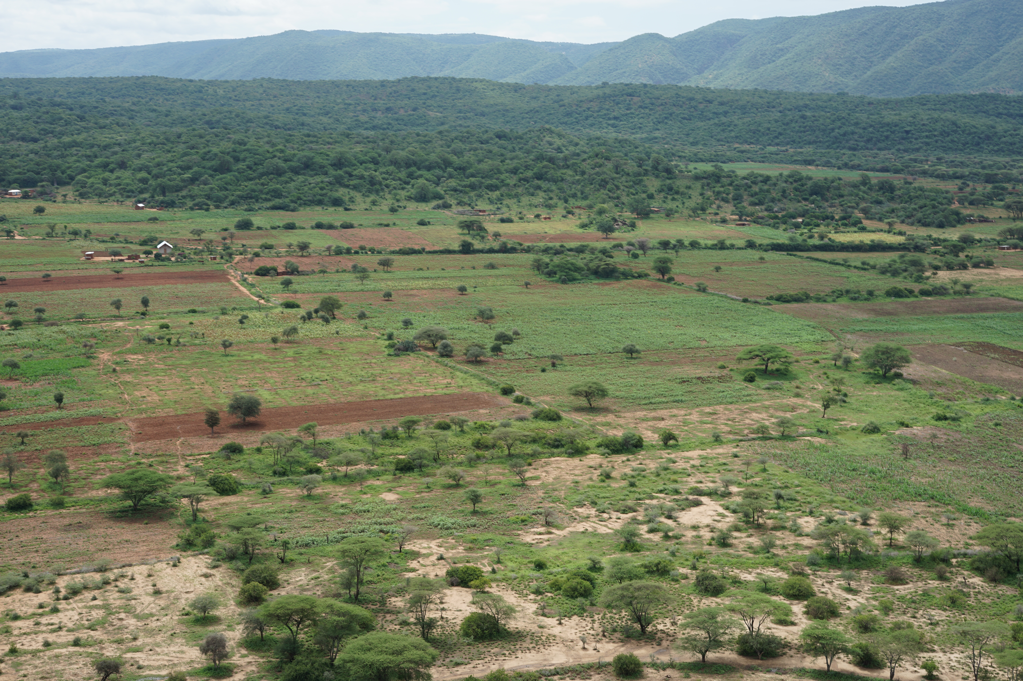

Slide 27
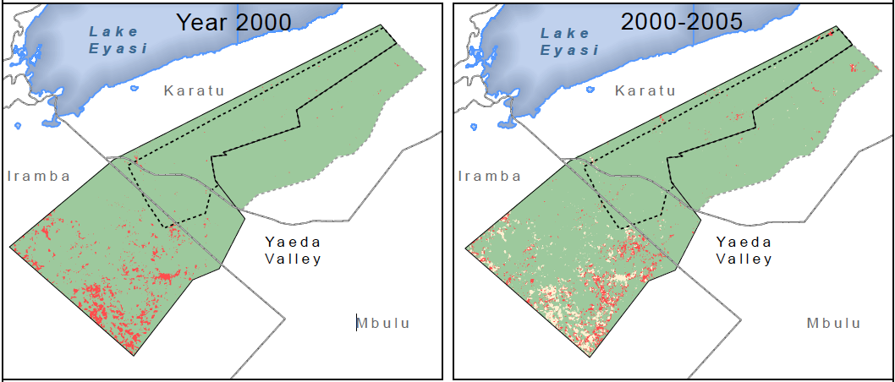
Land cover change from Acacia woodland to agriculture in Yaeda – 2000 to 2005
CCRO - Hadza
CCRO - Hadza
CCRO - Grazing
CCRO - Grazing
Agriculture
Agriculture

Slide 28
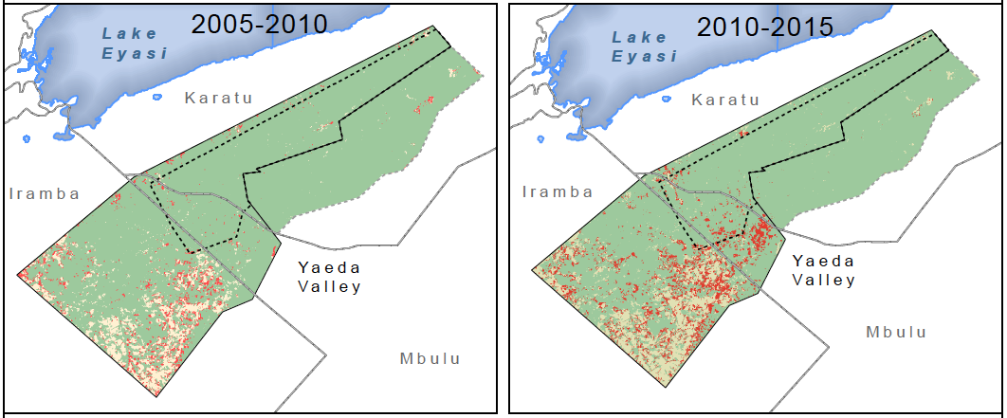
Land cover change from Acacia woodland to agriculture in Yaeda – 2005 to 2015
CCRO - Hadza
CCRO - Hadza
CCRO - Grazing
CCRO - Grazing
Agriculture
Agriculture

Slide 29
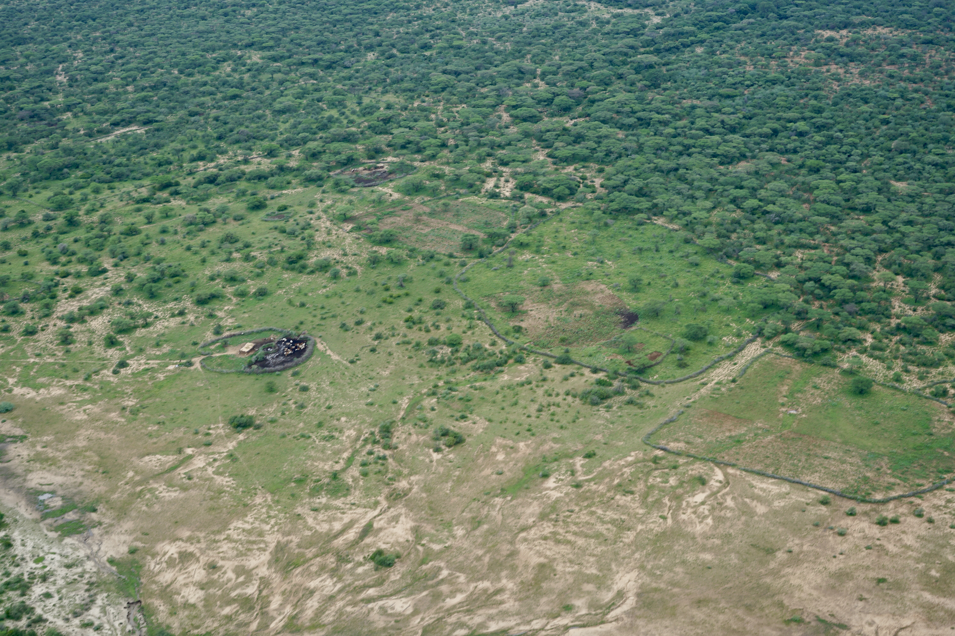

Slide 30
No land use planning
2.1%/year and increasing
VLUP + CCRO with no enforcement
0.26%/year and increasing
VLUP + CCRO with enforcement
0.1%/year and decreasing

Slide 31
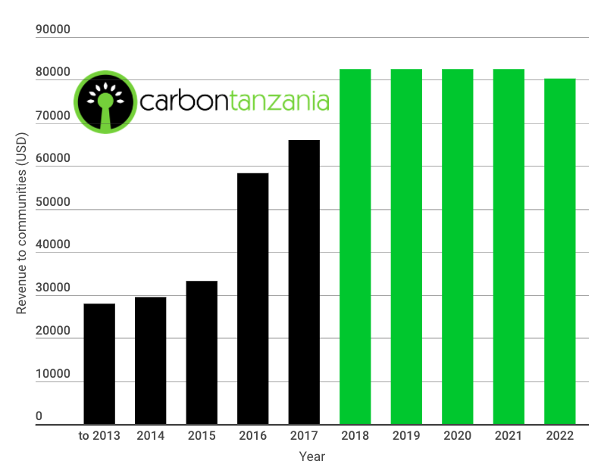
Notes:
Our sales trajectory from 2011 to 2022

Slide 32
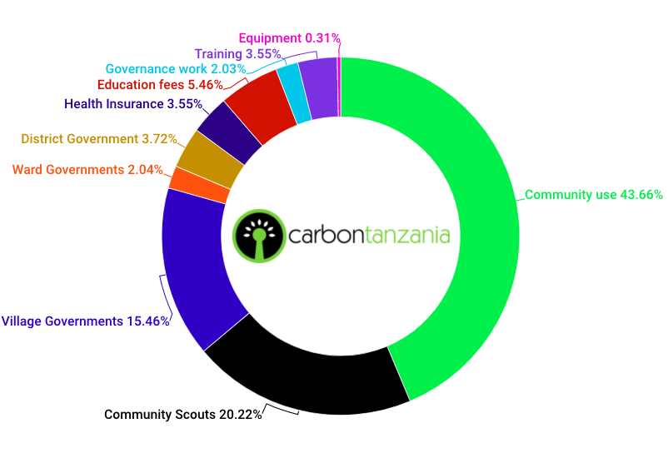
Revenue to communities 2012-2017
USD 218,876
Notes:
How the communities spend their money

Slide 33
